Slide 1
DDR4 Status
Zhengjianqiang

Slide 2
VT Status
 | Board #13 |  |  |  |  | Board #15 |  |  |  |  | Board #18
DDR rate(Mbps) | NVNT | HVNT | LVNT | HVLT | LVHT | NVNT | HVNT | LVNT | HVLT | LVHT | NVNT | HVNT | LVNT | HVLT | LVHT
1200 | PASS |  |  |  |  | PASS |  |  |  |  | PASS
1600 | PASS |  |  |  |  | PASS |  |  |  |  | PASS
1866 | PASS |  |  |  |  | PASS |  |  |  |  | PASS
2133 | PASS |  |  | PASS | PASS | PASS |  |  | PASS | PASS | PASS |  |  | PASS | PASS
2400 | PASS | PASS |  |  |  | FAIL | PASS |  |  |  | PASS | PASS
Notes: 1. below 2133Mbps, only do the NVNT case.
VT Condition | High | Low
Voltage | Core: 0.9*(1+5%) ; DDR: 1.2*(1+5%) | Core: 0.9*(1-5%) ; DDR: 1.2*(1-5%)
Temperature | 60 degree C | -10 degree C

Slide 3
Issue Point
Byte7,6,1 have small valid eye window at 2400Mbps
Under low voltage case(vddq=1.2V*0.95=1.14V), the small valid eye will result in error, which had found at board #18 and board #14.
Under high voltage case(vddq=1.2V*1.05=1.26V), the overnight test can pass at these boards.
So the weak point is at byte 7,6,1. Had excluded the board level reason, post simulation would be involved.

Slide 4
Current 2400 timing setting
 | current DDR timing settings
param. | value(0x) | notes | register
wr2pre | 14 |  | ddr_ctr_base + 0x0100
t_faw | 13
t_ras_max | 28
t_ras_min | 14
t_xp | 4 |  | ddr_ctr_base + 0x0104
rd2pre | 5
t_rc | 1b
wl | 8 |  | ddr_ctr_base + 0x0108
rl | 8
rd2wr | 3
wr2rd | f
t_mrw | 0 | only for LPDDR2 | ddr_ctr_base + 0x010c
t_mrd | 4
t_mod | c
t_rcd | 4 |  | ddr_ctr_base + 0x0110
t_ccd | 2
t_rrd | 3
t_rp | 5
t_cksrx | 3 |  | ddr_ctr_base + 0x0114
t_cksre | 3
t_ckesr | 3
t_cke | 2
t_ckdpde | 0 | only for LPDDR2 | ddr_ctr_base + 0x0118
t_ckdpdx | 0 | only for LPDDR2
t_ckcsx | 0 | only for LPDDR2
t_ckpde | 7 | only for LPDDR2 | ddr_ctr_base + 0x011c
t_ckpdx | 7 | only for LPDDR2
t_xs_fast_x32 | 3 |  | ddr_ctr_base + 0x0120
t_xs_abort_x32 | 3
t_xs_dll_x32 | c
t_xs_x32 | 6
ddr4_wr_preamble | 0 |  | ddr_ctr_base + 0x0124
t_ccd_s | 2
t_rrd_s | 4
wr2rd_s | c
t_sync_gear | 10 |  | ddr_ctr_base + 0x0128
t_cmd_gear | c
t_gear_setup | 2
t_gear_hold | 2
tXMPDLL | 12 |  | ddr_ctr_base + 0x012c
t_mpx_lh | 9
t_mpx_s | 1
t_ckmpe | e
t_cmdcke | 0 | LPDDR4 | ddr_ctr_base + 0x0130
t_mrd_pda | d
odtloff | default | LPDDR4 | ddr_ctr_base + 0x0134
t_ccd_mw | default | LPDDR4
t_ppd | default | LPDDR4
t_xsr | 0 | MEMC_MOBILE_OR_LPDDR2 | ddr_ctr_base + 0x0138
en_dfi_lp_t_stab | 1 |  | ddr_ctr_base + 0x013c
en_hwffc_t_stab | 0
t_stab_x32 | 0

Slide 5
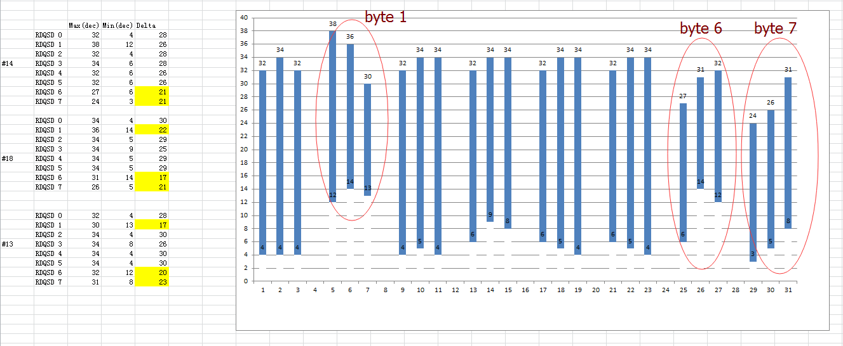
DDR4 2400 valid window at NVNT
Result showed that there is small valid window at byte1, byte6 and byte7.
The overnight memtester test also found errors at the three bytes.

Slide 6
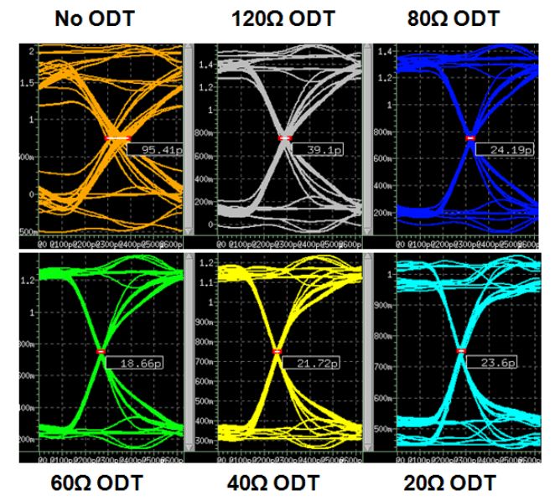
DRV strength and ODT
The ODT is important for the signal quality.
The best combination and also currently used is:
Direction | ODT(ohm) | DRV(ohm)
Read(DDR chip→ SOC) | 80 | 40
Write(SOC→DDR chip) | 120 | 34

Slide 7
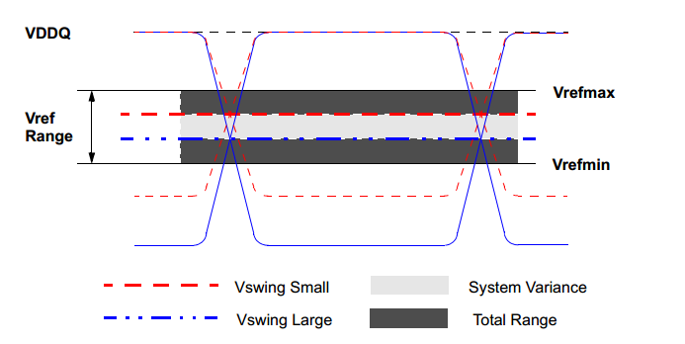
VrefDQ Selection
During debug, found that Vref trained value is bigger.
Decreased the max value for training to limit the trained value was helpful.

Slide 8
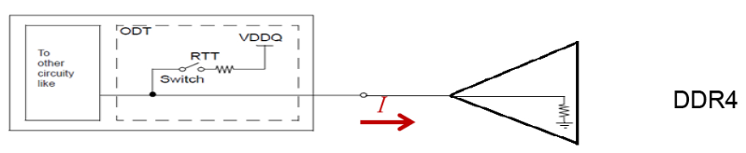
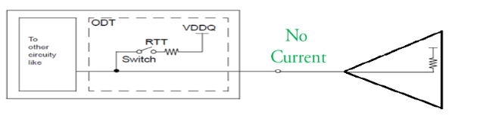
POD IO
New feature firstly used at DDR4 standard
Together with DBI function can save the power consumption
Met issue at first bring up DDR 2400Mbps without enable Pull up only POD IO

Slide 9
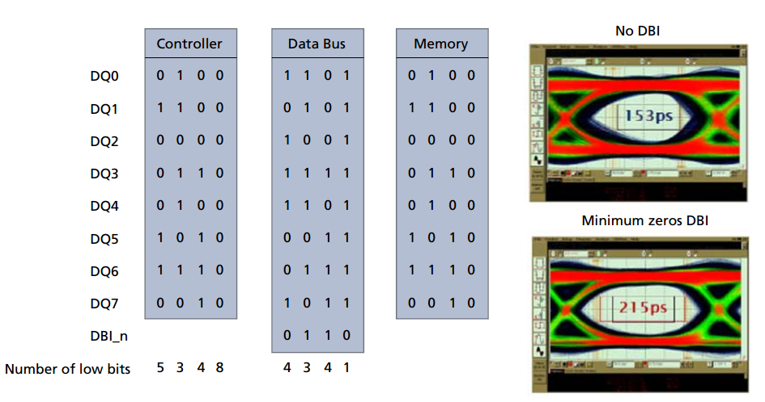
DBI Enable
DBI enable improves the signal quality obviously.

Slide 10
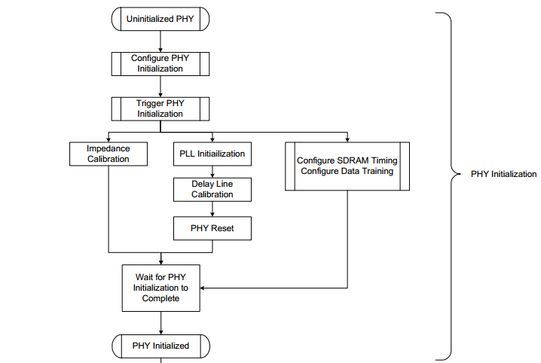
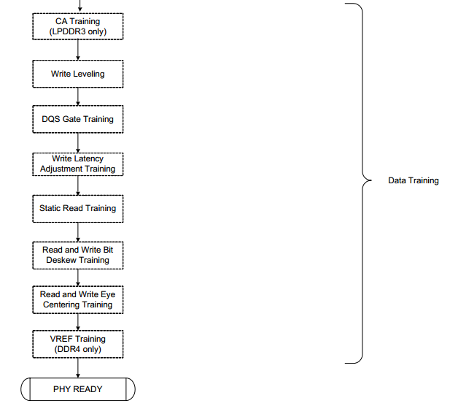
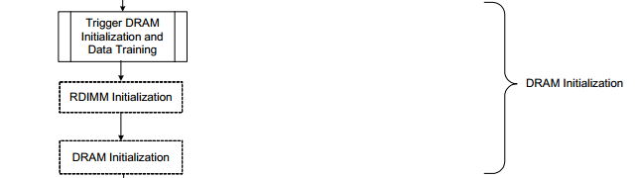
Training Step

Slide 11
Compiler Environment
Change the setting at dram_sirius.c
Need to compile the whole system, included U boot and linux system manually.
If need to change the ddr4 rate, change the init function at board.c at the same directory with dram_sirius.c
Detailed see the file “how to compile the ddr setting file”

